Slide 1
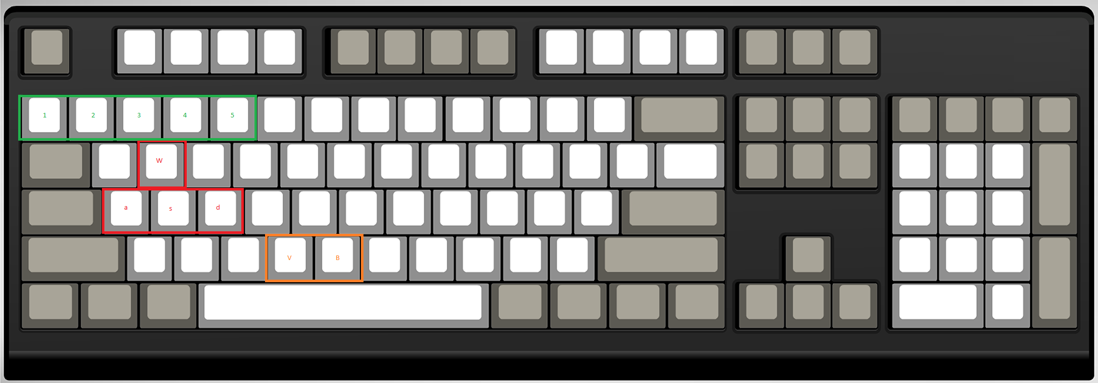
Battlement Blast Control Guide
To join, press Multiplayer then List All Games in center of screen. Wait for a game to be hosted. When you first enter, it will be the build phase. To build, press B. For more details, see the green text. The reason for building is to give you a defensive or strategic advantage. Each team has a core at spawn. It is the purple item with particles coming out of it. This is your respawn point. Once the build phase of 3 minutes is over, combat begins. All barriers are removed between teams. Fight it out. In between teams on parts of the map are contention points. It works in King of the Hill fashion. Stay in the point for a few seconds and capture it to gain a consistent flow of resources. The idea is to destroy the enemy core. The enemy core is where they respawn. Finish the game by leaving no one on the enemy team standing. If your core is destroyed, not all is lost. You cannot respawn but you get one last life!
Use WASD keys and mouse to look around.
Shoot with left mouse.
If you have sniper, zoom with right click.
In build menu (B), press 1-5 to select and place with mouse. Floors must be used as a foundation. Objects can only be placed when highlighted blue, else they will show red. To build you need resources. Collect then at points of interests like statues, sheds, and contention points. In gun menu (V), simply press 1-5 to purchase a weapon and it will take the resources from your team

